Slide 1
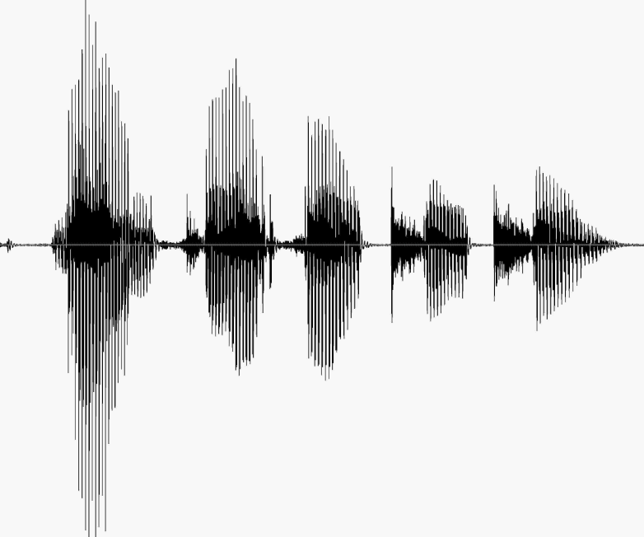
CS 224S / LINGUIST 285 Spoken Language Processing
Andrew Maas
Stanford University
Spring 2017
Lecture 11: Emotion/Affect Extraction and Interpersonal Stance
Original slides by Dan Jurafsky

Slide 2
Outline
Theoretical background on emotion and smiles
Extracting emotion from speech and text: case studies and features
Interpersonal stance and speed dating case study

Slide 3
Social Signal Processing = Affect/Emotion Detection
Detecting frustration of callers to a help line
Detecting stress in drivers or pilots
Detecting depression, intoxication
Detecting interest, certainty, confusion in on-line tutors
Pacing/Positive feedback
Hot spots in meeting summarizers/browsers
Synthesis/generation:
On-line literacy tutors in the children’s storybook domain
Computer games

Slide 4
Scherer’s typology of affective states
Emotion: relatively brief episode of synchronized response of all or most organismic subsystems in response to the evaluation of an external or internal event as being of major significance
angry, sad, joyful, fearful, ashamed, proud, desperate
Mood: diffuse affect state …change in subjective feeling, of low intensity but relatively long duration, often without apparent cause
cheerful, gloomy, irritable, listless, depressed, buoyant
Interpersonal stance: affective stance taken toward another person in a specific interaction, coloring the interpersonal exchange
distant, cold, warm, supportive, contemptuous
Attitudes: relatively enduring, affectively colored beliefs, preferences predispositions towards objects or persons
liking, loving, hating, valuing, desiring
Personality traits: emotionally laden, stable personality dispositions and behavior tendencies, typical for a person
nervous, anxious, reckless, morose, hostile, envious, jealous

Slide 5
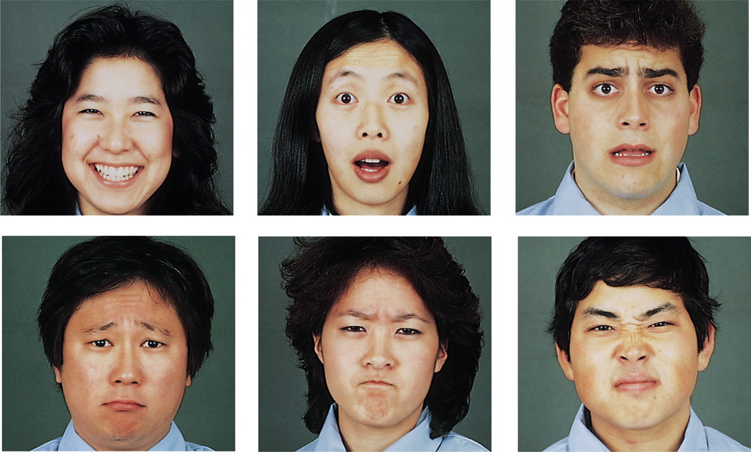
Ekman’s 6 basic emotions
Surprise, happiness, anger, fear, disgust, sadness
Notes:
Ekman and his colleagues did 4 studies to add support for their hypothesis that certain basic emotions (fear, surprise, sadness, happiness, anger, disgust) are universally recognized across cultures. This supports the theory that emotions are evolutionarily adaptive and unlearned.
Study #1
Ekman, Friesen, and Tomkins: showed facial expressions of emotion to observers in 5 different countries (Argentina, US, Brazil, Chile, & Japan) and asked the observers to label each expression. Participants from all five countries showed widespread agreement on the emotion each of these pictures depicted.
Study #2
Ekman, Sorenson, and Friesen: conducted a similar study with preliterate tribes of New Guinea (subjects selected a story that best described the facial expression). The tribesmen correctly labeled the emotion even though they had no prior experience with print media.
Study #3
Ekman and colleagues: asked tribesman to show on their faces what they would look like if they experienced the different emotions. They took photos and showed them to Americans who had never seen a tribesman and had them label the emotion. The Americans correctly labeled the emotion of the tribesmen.
Study #4
Ekman and Friesen conducted a study in the US and Japan asking subjects to view highly stressful stimuli as their facial reactions were secretly videotaped. Both subjects did show exactly the same types of facial expressions at the same points in time, and these expressions corresponded to the same expressions that were considered universal in the judgment research.

Slide 6
Dimensional approach. (Russell, 1980, 2003)
High arousal, High arousal,
Displeasure (e.g., anger) High pleasure (e.g., excitement)
valence Low arousal, Low arousal,
Displeasure (e.g., sadness) High pleasure (e.g., relaxation)
arousal
Slide from Julia Braverman

Slide 7
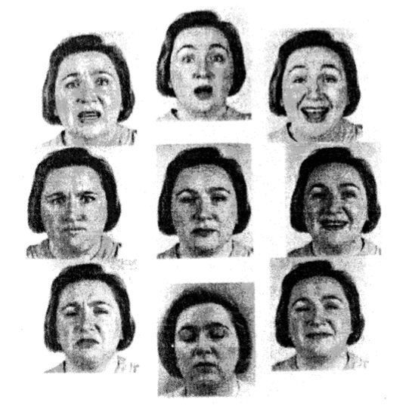
Image from Russell 1997
Image from
Russell, 1997
valence
-
+
-
arousal
Notes:
Engagement
Learning (memory, problem-solving, attention)
Motivation

Slide 8
Distinctive vs. Dimensional approach
Distinctive
Emotions are units.
Limited number of basic emotions.
Basic emotions are innate and universal
Methodology advantage
Useful in analyzing traits of personality.
Dimensional
Emotions are dimensions.
Limited # of labels but unlimited number of emotions.
Emotions are culturally learned.
Methodological advantage:
Easier to obtain reliable measures.
Slide from Julia Braverman

Slide 9
Duchenne versus non-Duchenne smiles
http://www.bbc.co.uk/science/humanbody/mind/surveys/smiles/
http://www.cs.cmu.edu/afs/cs/project/face/www/facs.htm

Slide 10
Duchenne smiles

Slide 11
How to detect Duchenne smiles
“As well as making the mouth muscles move, the muscles that raise the cheeks – the orbicularis oculi and the pars orbitalis – also contract, making the eyes crease up, and the eyebrows dip slightly.
Lines around the eyes do sometimes appear in intense fake smiles, and the cheeks may bunch up, making it look as if the eyes are contracting and the smile is genuine.
But there are a few key signs that distinguish these smiles from real ones. For example, when a smile is genuine, the eye cover fold - the fleshy part of the eye between the eyebrow and the eyelid - moves downwards and the end of the eyebrows dip slightly.”
BBC Science webpage referenced on previous slide

Slide 12
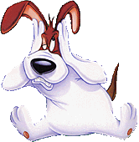
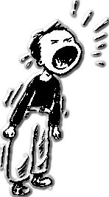
Emotional communication and the Brunswikian Lens
Example:
Loud voice
High pitched
Frown
Clenched fists
Shaking
Vocal cues
cues
Facial cues
Gestures
Other cues …
Expressed emotion
Emotional attribution
expressed anger ?
perception of anger?
encoder
decoder
slide from Tanja Baenziger

Slide 13
Implications for HCI
If matching is low…
cues
Expressed emotion
Emotional attribution
relation of the cues to the expressed emotion
relation of the cues to the perceived emotion
Important for Extraction
matching
Important for Agent generation
Generation (Conversational agents): relation of cues to perceived emotion
Recognition (Extraction systems): relation of the cues to expressed emotion
slide from Tanja Baenziger

Slide 14
Extroversion in Brunswikian Lens
Simulated jury discussions in German and English
speakers had detailed personality tests
Extroversion personality type accurately identified from naïve listeners by voice alone
But not emotional stability
listeners choose: resonant, warm, low-pitched voices
but these don’t correlate with actual emotional stability
I

Slide 15
Acoustic implications of Duchenne smile
Amy Drahota, Alan Costall, Vasudevi Reddy. 2008.
The vocal communication of different kinds of smile. Speech Communication
“Asked subjects to repeat the same sentence in response to a set sequence of 17 questions, intended to provoke reactions such as amusement, mild embarrassment, or just a neutral response.”
Coded and examined Duchenne, non-Duchenne, and “suppressed” smiles”.
Listeners could tell the differences, but many mistakes
Standard prosodic and spectral (formant) measures showed no acoustic differences of any kind.
Correlations between listener judgments and acoustics:
larger differences between f2 and f3-> not smiling
smaller differences between f1 and f2 -> smiling

Slide 16
Evolution and Duchenne smiles
“honest signals” (Pentland 2008)
“behaviors that are sufficiently expensive to fake that they can form the basis for a reliable channel of communication”

Slide 17
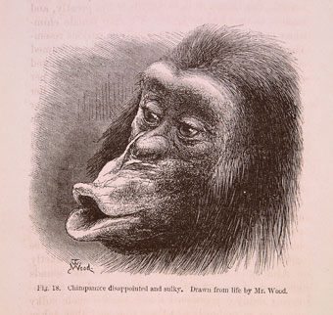
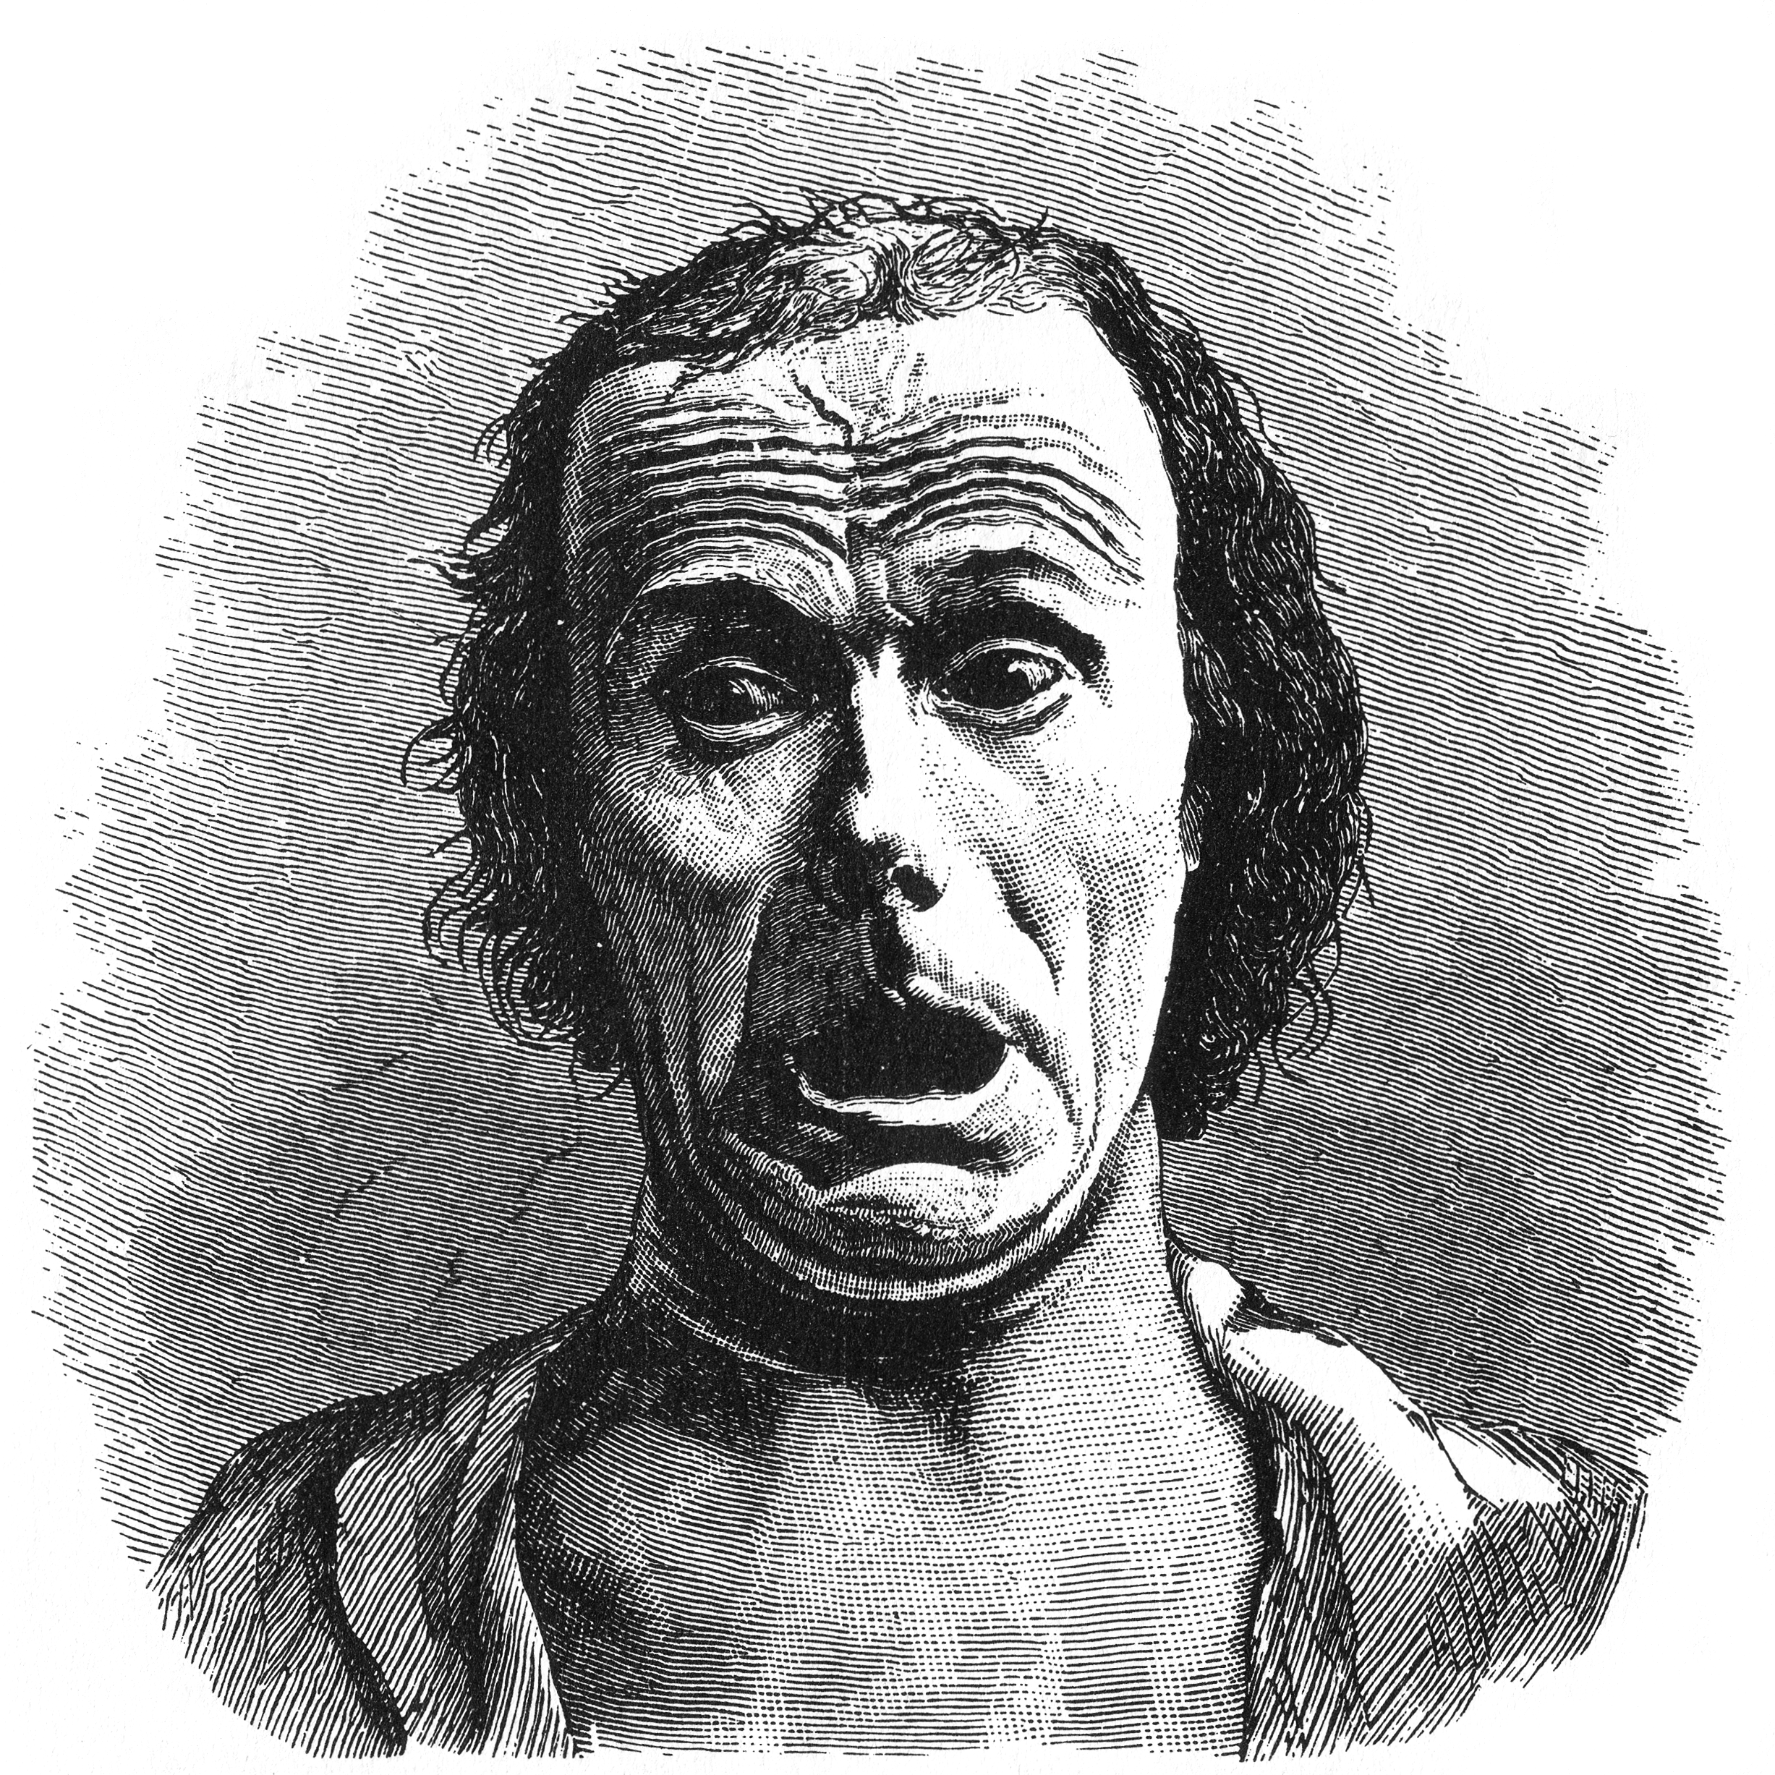
Four Theoretical Approaches to Emotion: 1. Darwinian (natural selection)
Darwin (1872) The Expression of Emotion in Man and Animals. Ekman, Izard, Plutchik
Function: Emotions evolve to help humans survive
Same in everyone and similar in related species
Similar display for Big 6+ (happiness, sadness, fear, disgust, anger, surprise) → ‘basic’ emotions
Similar understanding of emotion across cultures
The particulars of fear may differ, but "the brain systems involved in mediating the function are the same in different species" (LeDoux, 1996)
extended from Julia Hirschberg’s slides discussing Cornelius 2000

Slide 18
Four Theoretical Approaches to Emotion: 2. Jamesian: Emotion is experience
William James 1884. What is an emotion?
Perception of bodily changes → emotion
“we feel sorry because we cry… afraid because we tremble"’
“our feeling of the … changes as they occur IS the emotion"
The body makes automatic responses to environment that help us survive
Our experience of these responses consitutes emotion.
Thus each emotion accompanied by unique pattern of bodily responses
Stepper and Strack 1993: emotions follow facial expressions or posture.
Botox studies:
Havas, D. A., Glenberg, A. M., Gutowski, K. A., Lucarelli, M. J., & Davidson, R. J. (2010). Cosmetic use of botulinum toxin-A affects processing of emotional languagePsychological Science, 21, 895-900.
Hennenlotter, A., Dresel, C., Castrop, F., Ceballos Baumann, A. O., Wohlschlager, A. M., Haslinger, B. (2008). The link between facial feedback and neural activity within central circuitries of emotion - New insights from botulinum toxin-induced denervation of frown muscle Cerebral Cortex, June 17.
extended from Julia Hirschberg’s slides discussing Cornelius 2000

Slide 19
Four Theoretical Approaches to Emotion: 3. Cognitive: Appraisal
An emotion is produced by appraising (extracting) particular elements of the situation. (Scherer)
Fear: produced by the appraisal of an event or situation as obstructive to one’s central needs and goals, requiring urgent action, being difficult to control through human agency, and lack of sufficient power or coping potential to deal with the situation.
Anger: difference: entails much higher evaluation of controllability and available coping potential
Smith and Ellsworth's (1985):
Guilt: appraising a situation as unpleasant, as being one's own responsibility, but as requiring little effort.
Adapted from Cornelius 2000
Notes:
Spiesman et al 1964
All participants watch subincision (circmcisions) video, but with
different soundtracks:
– No sound
– Trauma narrative: emphasized pain
– Denial narrative: emphasized joyful ceremony
– Scientific narrative: detached tone
Measured heart rate and self-reported stress.
Who was most stressed?
Most stressed: Trauma narrative
Next most stressed: No sound
Least stressed: Denial narrative, Scientific narrative

Slide 20
Four Theoretical Approaches to Emotion: 4. Social Constructivism
Emotions are cultural products (Averill)
Explains gender and social group differences
anger is elicited by the appraisal that one has been wronged intentionally and unjustifiably by another person. Based on a moral judgment
don’t get angry if you yank my arm accidentally
or if you are a doctor and do it to reset a bone
only if you do it on purpose
Adapted from Cornelius 2000

Slide 21
Link between valence/arousal and Cognitive-Appraisal model
Dutton and Aron (1974)
Male participants cross a bridge
sturdy
precarious
Other side of bridge: female asks participants to take part in a survey
willing participants were given interviewer’s phone number
Participants who crossed precarious bridge
more likely to call and use sexual imagery in survey
Participants misattributed their arousal as sexual attraction

Slide 22
Part II: Case studies and features

Slide 23
Hard Questions in Emotion Recognition
How do we know what emotional speech is?
Acted speech vs. natural (hand labeled) corpora
What can we classify?
Distinguish among multiple ‘classic’ emotions
Distinguish
Valence: is it positive or negative?
Activation: how strongly is it felt? (sad/despair)
What features best predict emotions?
What techniques best to use in classification?
Slide from Julia Hirschberg

Slide 24
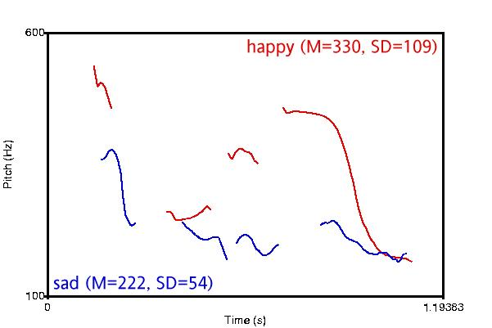

Major Problems for Classification: Different Valence/Different Activation
slide from Julia Hirschberg
Notes:
It is useful to note where direct modeling features fall short: While mean f0 successfully differentiates between emotions with different valence, so long as they have different degrees of activation…

Slide 25
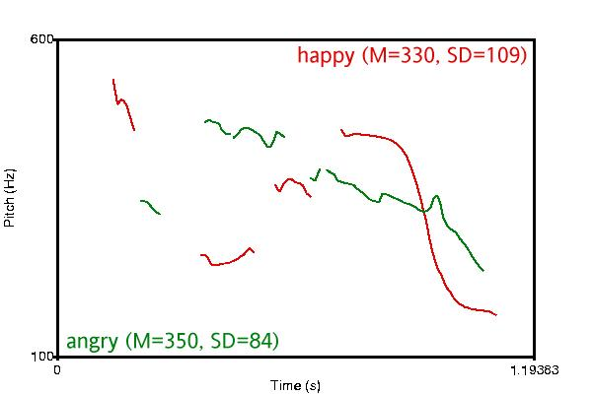
But…. Different Valence/ Same Activation
slide from Julia Hirschberg
Notes:
When different valence emotions such as happy and angry have the same activation, simple pitch features are less successful.

Slide 26
Data and tasks for Emotion Detection
Scripted speech
Acted emotions, often using 6 emotions
Controls for words, focus on acoustic/prosodic differences
Features:
F0/pitch
Energy
Speaking rate
Spontaneous speech
More natural, harder to control
Kinds of emotion focused on:
frustration,
annoyance,
certainty/uncertainty
“activation/hot spots”

Slide 27
Four quick case studies
Acted speech:
LDC’s EPSaT
Annoyance/Frustration in natural speech
Ang et al. on Annoyance and Frustration
Basic emotions cross linguistically (read on your own)
Braun and Katerbow, dubbed speach
Uncertainty in natural speech:
Liscombe et al’s ITSPOKE

Slide 28
Example 1: Acted speech: Emotional Prosody Speech and Transcripts Corpus (EPSaT)
Recordings from LDC
http://www.ldc.upenn.edu/Catalog/LDC2002S28.html
8 actors read short dates and numbers in 15 emotional styles

Slide 29
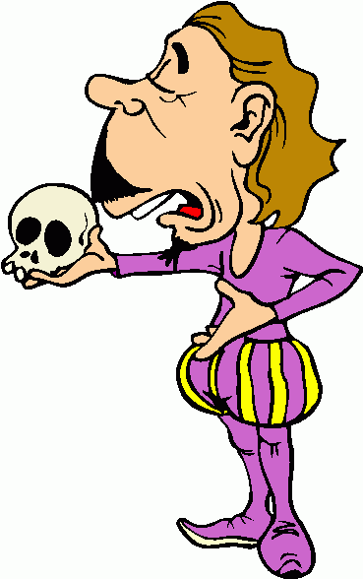
EPSaT Examples
happy
sad
angry
confident
frustrated
friendly
interested
anxious
bored
encouraging

Slide 30
Liscombe et al. 2003 Features Automatic Acoustic-Prosodic
F0
min, max, mean, range, stdev, above
Energy [RMS]
min, max, mean, range, stdev, above
Voicing
vcd (percentage of voiced frames)

Slide 31
Liscombe et al. 2003 Features Semi-Automatic Acoustic-Prosodic
Spectral Tilt: H2 – H1
computed over 30 ms window centered on middle of vowel
Vowel with hand-labeled nuclear stress
main stressed vowel of the intonation phrase
Loudest vowel
vowel with highest RMS
Syllable Length
ToBI
Nuclear accent type (L*, H*, L+H*)
Boundary tone type (H-H%, L-L%, etc)

Slide 32
Global Pitch Statistics

Slide 33
Global Pitch Statistics

Slide 34
Correlation between emotion and acoustics
a
positive-activation emotions (angry, frustrated, happy, confident):
high F0, RMS, speed
positive versus negative valence: TILT (positive valence = negative tilt)

Slide 35
Human labels for each sentence

Slide 36
Liscombe et al. Experiments
Binary Classification for Each Emotion,
‘not at all’ versus other
Ripper, 90/10 split
75% accuracy compared to 62% most-frequent-class baseline

Slide 37
Example 2 - Ang 2002
Ang, Shriberg, Stolcke. 2002. “Prosody-based automatic detection of annoyance and frustration in human-computer dialog”
DARPA Communicator “ Travel Planning” 837 dialogs, 21,819 utts
How reliably can humans and machines label annoyance and frustration?
What prosodic or other features are useful?

Slide 38
Data Annotation
5 undergrads with different backgrounds
Each dialog labeled by 2+ people independently
2nd “Consensus” pass for all disagreements, by two of the same labelers

Slide 39
Data Labeling
Emotion: neutral, annoyed, frustrated, tired/disappointed, amused/surprised, no-speech/NA
Speaking style: hyperarticulation, perceived pausing between words or syllables, raised voice
Repeats and corrections: repeat/rephrase, repeat/rephrase with correction, correction only
Miscellaneous useful events: self-talk, noise, non-native speaker, speaker switches, etc.

Slide 40

Emotion Samples
Neutral
July 30
Yes
Disappointed/tired
No
Amused/surprised
No
Annoyed
Yes
Late morning (HYP)
Frustrated
Yes
No
No, I am … (HYP)
There is no Manila...
3
1
2
8
6
4
5
9
7
10

Slide 41

Emotion Class Distribution
To get enough data, grouped annoyed and frustrated, versus else (with speech)

Slide 42
Prosodic Model
Classifier: CART-style decision trees
Downsampled to equal class priors
Automatically extracted prosodic features based on recognizer word alignments
Used 3/4 for train, 1/4th for test, no call overlap

Slide 43
Prosodic Features
Duration and speaking rate features
duration of phones, vowels, syllables
normalized by phone/vowel means in training data
true or recognized phones
normalized by speaker (all utterances, first 5 only)
speaking rate (vowels/time)
Pause features
duration and count of utterance-internal pauses at various threshold durations
ratio of speech frames to total utt-internal frames

Slide 44
Features (cont.)
Spectral tilt features
average of 1st cepstral coefficient
average slope of linear fit to magnitude spectrum
difference in log energies btw high and low bands
extracted from longest normalized vowel region

Slide 45
Pitch Features
minimum and maximum utterance pitch
raw and speaker-normalized
maximum pitch inside longest normalized vowel
slopes at various locations
normalized by speakers F0 range

Slide 46
Language Model Features
Train two 3-gram class-based LMs
one on frustration, one on other.
Given a test utterance, chose class that has highest LM likelihood (assumes equal priors)
In prosodic decision tree, use sign of the likelihood difference as input feature

Slide 47
Results (cont.)
H-H labels agree 72%
H labels agree 84% with “consensus” (biased)
Tree model agrees 76% with consensus-- better than original labelers with each other
Language model features alone (64%) are not good predictors

Slide 48
Prosodic Predictors of Annoyed/Frustrated
Pitch:
high maximum fitted F0 in longest normalized vowel
high speaker-norm. (1st 5 utts) ratio of F0 rises/falls
maximum F0 close to speaker’s estimated F0 “topline”
minimum fitted F0 late in utterance (no “?” intonation)
Duration and speaking rate:
long maximum phone-normalized phone duration
long max phone- & speaker- norm.(1st 5 utts) vowel
low syllable-rate (slower speech)

Slide 49
Ang et al ‘02 Conclusions
Emotion labeling is a complex task
Prosodic features:
duration and stylized pitch
speaker normalizations help
“N-gram probability ratio” is a bad feature

Slide 50
Example 3: Basic Emotions across languages
Braun and Katerbow
F0 and the basic emotions
Using “comparable corpora”
English, German and Japanese
Dubbing of the TV show Ally McBeal into German and Japanese

Slide 51
Results: Male speakers
a
Difference between emotional and neutral speech

Slide 52
Results: Female speakers
a
Difference between emotional and neutral speech

Slide 53
Perception
A Japanese male joyful speaker:
Confusion matrix: % of misrecognitions
Japanese perceiver: American perceiver:

Slide 54
Example 4: Intelligent Tutoring Spoken Dialogue System
ITSpoke
Diane Litman, Katherine Forbes-Riley, Scott Silliman, Mihai Rotaru
Jackson Liscombe, Julia Hirschberg, Jennifer J. Venditti. 2005. Detecting Certainness in Spoken Tutorial Dialogues

Slide 55
Tutorial corpus
151 dialogues from 17 subjects
student first writes an essay, then discusses with tutor
both are recorded with microphones
manually transcribed and segmented into turns
6778 student utterances (average 2.3 seconds)
each utterance hand-labeled for certainty

Slide 56
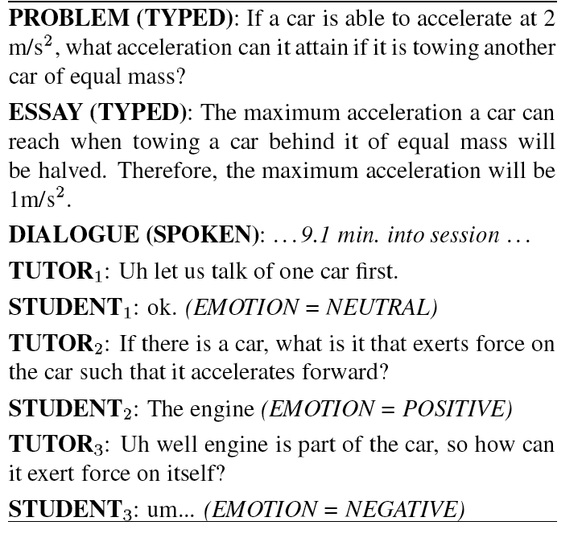

Slide 57
Corpus Statistics
64.2% neutral
18.4% certain
13.6% uncertain
3.8% mixed

Slide 58
Uncertainty in ITSpoke
um <sigh> I don’t even think I have an idea here ...... now .. mass isn’t weight ...... mass is ................ the .......... space that an object takes up ........ is that mass?
um <sigh> I don’t even think I have an idea here ...... now .. mass isn’t weight ...... mass is ................ the .......... space that an object takes up ........ is that mass?
um <sigh> I don’t even think I have an idea here ...... now .. mass isn’t weight ...... mass is ................ the .......... space that an object takes up ........ is that mass?
um <sigh> I don’t even think I have an idea here ...... now .. mass isn’t weight ...... mass is ................ the .......... space that an object takes up ........ is that mass?
um <sigh> I don’t even think I have an idea here ...... now .. mass isn’t weight ...... mass is ................ the .......... space that an object takes up ........ is that mass?
[71-67-1:92-113]
Notes:
One ‘.’ corresponds to 0.25 seconds.

Slide 59
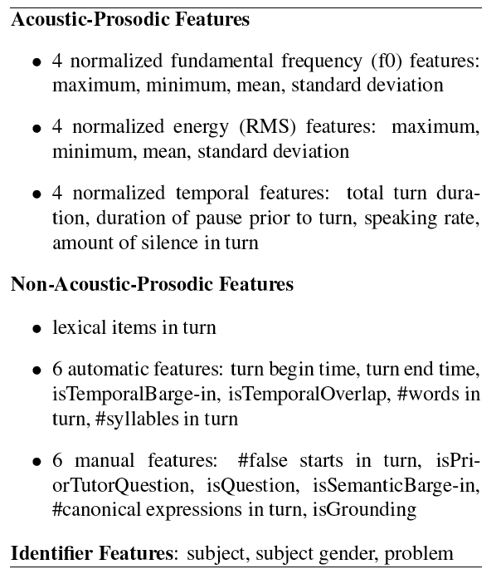

Slide 60
Turns and Breath groups
Turns were very long
All features also extracted over breath groups
Data was labeled only for turns, so use BG as feature
45 features from first, last and longest BG

Slide 61
Liscombe et al: ITSpoke Experiment
Human-Human Corpus
AdaBoost(C4.5) 90/10 split in WEKA
Classes: Uncertain vs Certain vs Neutral
Results:
Features | Accuracy
Baseline | 66%
Acoustic-prosodic | 75%

Slide 62
A tutorial system that adapts to uncertainty
Forbes-Riley, Kate, and Diane Litman. "Benefits and challenges of real-time uncertainty detection and adaptation in a spoken dialogue computer tutor." Speech Communication 53, no. 9 (2011): 1115-1136.

Slide 63
Features for uncertainty
a

Slide 64
Conclusions
Uncertainty is very hard to detect
Certainty is easier
Even so, the system improved learner outcomes

Slide 65
Disengagement in ITSpoke 2
Kate Forbes-Riley, Diane Litman, Heather Friedberg, Joanna Drummond. 2012. Intrinsic and Extrinsic Evaluation of an Automatic User Disengagement Detector for an Uncertainty-Adaptive Spoken Dialogue System. NAACL 2012.

Slide 66
Disengagement Features
Upper level of tree consists entirely of prosody, question name/depth
Most important feature: Pause prior to start of turn
<250ms means disengagement!!!!

Slide 67
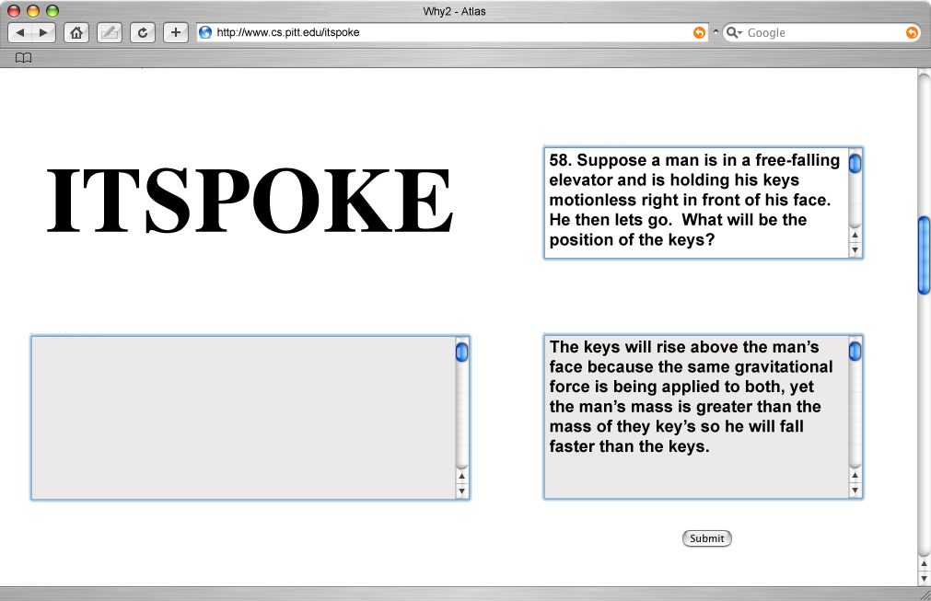
[pr01_sess00_prob58]

Slide 68
Scherer summary: Prosodic features for emotion

Slide 69
Interpersonal stance

Slide 70
Scherer’s typology of affective states
Emotion: relatively brief episode of synchronized response of all or most organismic subsystems in response to the evaluation of an external or internal event as being of major significance
angry, sad, joyful, fearful, ashamed, proud, desperate
Mood: diffuse affect state …change in subjective feeling, of low intensity but relatively long duration, often without apparent cause
cheerful, gloomy, irritable, listless, depressed, buoyant
Interpersonal stance: affective stance taken toward another person in a specific interaction, coloring the interpersonal exchange
distant, cold, warm, supportive, contemptuous
Attitudes: relatively enduring, affectively colored beliefs, preferences predispositions towards objects or persons
liking, loving, hating, valuing, desiring
Personality traits: emotionally laden, stable personality dispositions and behavior tendencies, typical for a person
nervous, anxious, reckless, morose, hostile, envious, jealous

Slide 71
Interpersonal Stance: Our Goals
Friendliness
Assertiveness
Flirtation
Awkwardness

Slide 72
Methodology
Speed-dating
Participants rate each other

Slide 73
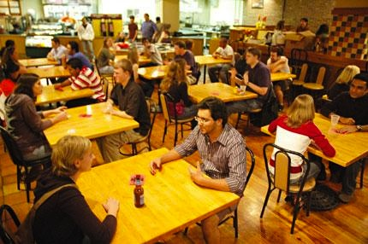
Speed dating
E.J. Finkel, P.W. Eastwick. 2008. Speed-dating. Current Directions in Psychological Science, 17 (3) (2008), p. 193
Place, S. S., Todd, P. M., Penke, L., & Asendorpf, J. B. (2009). The ability to judge the romantic interest of others. Psychological Science, 20(1), 22-26.
M.E. Ireland, R.B. Slatcher, P.W. Eastwick, L.E. Scissors, E.J. Finkel, J.W. Pennebaker. 2011. Language style matching predicts relationship initiation and stability. Psychological Science, 22 (1) (2011), p. 39

Slide 74
What do you do for fun? Dance?
Uh, dance, uh, I like to go, like camping. Uh, snowboarding, but I'm not good, but I like to go anyway.
You like boarding.
Yeah. I like to do anything. Like I, I'm up for anything.
Really?
Yeah.
Are you open-minded about most everything?
Not everything, but a lot of stuff-
What is not everything [laugh]
I don't know. Think of something, and I'll say if I do it or not. [laugh]
Okay. [unintelligible].
Skydiving. I wouldn't do skydiving I don't think.
Yeah I'm afraid of heights.
F: Yeah, yeah, me too.
M: [laugh] Are you afraid of heights?
F: [laugh] Yeah [laugh]

Slide 75
Background: Previous work on Pickiness in Dating
Finkel and Eastwick 2009, Psych Science
Men are less selective than women in speed dating
Novel explanation: act of physically approaching a partner increases attraction to that partner
traditional events, always men rotates
Ran 15 speed dating events
in 8, men rotated: men more selective
in 7, women rotated: men equally selective to women
Conclusion?

Slide 76
Background: Friendliness
English (Liscombe et al.; 2003)
Friendly speech: higher f0 min, mean, max
but all other positive valence similar
Higher spectral tilt (H2-H1) of stressed vowel
Swedish (House; 2005)
Higher F0 in questions (especially late in syllable) friendlier than low F0 or a peak early in the syllable.
Chinese (Chen et al. 2004, Li and Wang 2004)
statements and questions produced by actors,
Friendly speech had higher mean F0, faster

Slide 77
Background: Flirtation/Attractiveness
Attractiveness
Raised F0 in women’s voices
Preferred by men (Feinberg et al 2008, Jones et al 2010)
Rated more attractive by men (Collins and Missing, 2003; Puts et al., 2011).
Lowered F0 or close harmonics in men’s voices
labeled by women as more attractive or masculine (Collins and Missing, 2003; Puts et al., 2011).
Flirtatiousness:
Higher F0 or dispersed formants in women’s voices
perceive as more flirtatious by other women (Puts et al., 2011).

Slide 78
Extracting social meaning
Stance
Friendly, flirt, awkward, assertive
Social Bond
Clicking or Connection
Romantic Interest
946 4-minute dates
~800K words, hand-transcribed
~60 hours, from shoulder sash recorders
3 events, 20x20=400 dates x 3
Date perceptions, demographics, preferences

Slide 79
Data annotation
Each speaker wore a microphone
So each date had two recordings
The wavefile from each speaker was manually segmented into 4-minute dates
Professional transcription service produced:
words, laughter, disfluencies
timestamps for turn beginning and end (1 second)
for 10% of the dates, timestamp at 0.1 second granularity
using both recordings

Slide 80
Study 1: What we attempted to predict
Conversational style:
How often did they behave in the following ways on this date?
On a scale of 1-10 (1=never, 10=constantly)
awkward
friendly
flirtatious
assertive

Slide 81
Features
Prosodic
pitch (min, mean, max, std)
intensity (min, max, mean, std)
duration of turn
rate of speech (words per second)
Lexical
negation words (don’t, didn’t, won’t, can’t, not, never)
hedges (kind of, sort of, probably, I don’t know)
personal pronouns (I, you, we, us)
Dialog
questions
backchannels (“uh-huh”, “yeah”)
appreciations (“Wow!”, “That’s great!”)
sympathy (“That’s awful!” “Oh, that sucks!”)

Slide 82
LIWC
Linguistic Inquiry and Word Count
Pennebaker, Francis, & Booth, 2001
dictionary of 2300 words grouped into > 70 classes, modified:
I: I’d, I’ll, I’m, I’ve, me, mine, my, myself (not counting I mean)
YOU: you, you’d, you’ll, your, you’re, yours, you’ve (not counting you know)
SEX: sex, sexy, sexual, stripper, lover, kissed, kissing
LOVE: love, loved, loving, passion, passions, passionate
HATE: hate, hates, hated
SWEAR: suck*, hell*, crap*, shit*, screw*, damn*, heck, f.ck*, ass*, ...
NEGEMOTION: bad, weird, hate, crazy, problem*, difficult, tough, awkward, boring
NEGATE: don’t, not, no, didn’t, never, can’t, doesn’t, wasn’t, nothing, isn’t, …

Slide 83
Additional lexical features
Hedges
kind of, sort of, a little, I don’t know, I guess
Work terms
research, advisor, lab, work, finish, PhD, department
Metadiscussion of dating
speed date, flirt, event, dating, rating
UH or UM:
M: Um, eventually, yeah, but right now I want to get some more experience, uh, in research.
Like, you know, I mean:

Slide 84
Speed date features extracted within turns: used for whole side
F0 max in this turn
F0 min in this turn
F0 max in this turn

Slide 85
Features: Pitch
F0 min, max, mean
Thus to compute, e.g., F0 min for a conversation side
Take F0 min of each turn (not counting zero values)
Average over all turns in the side
“F0 min, F0 max, F0 mean”
We also compute measures of variation
Standard deviation, pitch range
F0 min sd, F0 max sd, F0 mean sd
pitch range = (f0 max – f0 min)

Slide 86
Prosodic features

Slide 87
Replace 18 factors with 6
Factor analysis, 6 factors explain 85% of variance

Slide 88
Prosodic Features: 6 factors
Higher Pitch Ceiling
Louder (Min, mean and max)
Higher Pitch Floor
Variable Loudness
Longer Turns
Variable Pitch
plus Rate of Speech

Slide 89
Positive and negative assessments
(Goodwin, 1996; Goodwin and Goodwin, 1987; Jurafsky et al., 1998
Sympathy
(that’s|that is|that seems|it is|that sounds)
(very|really|a little|sort of)?
(terrible|awful|weird|sucks|a problem|tough|too bad)
Appreciations (“Positive feedback”)
(Oh)? (Awesome|Great|All right|Man|No kidding|wow|my god)
That
(‘s|is|sounds|would be)
(so|really)?
(great|funny|good|interesting|neat|amazing|nice|not bad|fun)

Slide 90
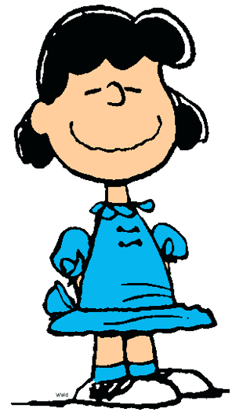
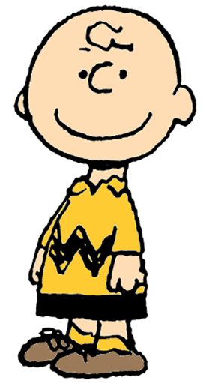
Clarifications
I’ve been goofing off big time
You’ve been what?
I’ve been goofing off big time

Slide 91
Regular Expression Patterns for Clarifications
What?
Sorry
Excuse me
Huh?
Who?
Pardon?
Say again?
Say it again?
What’s that
What is that

Slide 92
Turn-initial Laughter
Laughing at your date’s joke:
MALE: .. “speed filling out forms” is what this should be called.
FEMALE: [laughter] Yeah.
or teasing:
MALE: You're on the rebound.
FEMALE: huh--uh.
MALE: [laughter] Defensive.

Slide 93
Turn medial/final Laughter
Laughing at yourself
FEMALE: Why are you single?
MALE: Why I'm single? That's a good question. [laughter]
MALE: And I stopped by the--the beer party the other day.
FEMALE: Oh goodness. And you saw me in- [laughter]

Slide 94
Other features
DISFLUENT RESTARTS : # of disfluent restarts in side
Uh, I–there’s a group of us that came in–
INTERRUPT: # of turns in side where speakers overlapped
M: But-and also obviously–
F: It sounds bigger.
M: –people in the CS school are not quite as social in general as other–

Slide 95
Accommodation features
Speakers change their behavior to match (or not match) their interlocutor
Natale 1975, Giles, Mulac, Bradac, & Johnson 1987, Bilous & Krauss 1988, Giles, Coupland, and Coupland, 1991, Giles and Coupland 1992, Niederhoffer and Pennebaker 2002, Pardo 2006, Nenkova and Hirschberg 2008, inter alia.
Matching rate of speech
Matching F0
Matching intensity (loudness)
Matching vocabulary and grammar
Matching dialect
Our question:
Is accommodation characteristic of certain interpersonal styles?

Slide 96
Simple measures of accommodation
Words that I used in turn i
that you used in turn i-1
function words (I, you, the, if, and, it, to…)
content words (department, party, lunch….)
correlation between our rates of speech
if I get faster do you get faster?
laugh accommodation
if I laugh do you laugh in the next turn?

Slide 97
Various sets of studies
Social science
mixed-effects logistic regressions with many control factors
BMI, height, age difference
foreign versus non-foreign student
Engineering
various classifiers, without the control factors

Slide 98
Controls for Social Science Studies
Actor and Partner Traits
Male gender – male (1,0)
Height – inches (standardized by gender)
BMI – Body mass index = weight (lb) / [height (in)]2 x 703 BM standardized by gender)
Foreign – foreign born (1,0)
Dating experience – respondent’s dating expertise
(7=several times a week, 6=twice a week, 5=once a week, 4=twice a month, 3=once a month, 2=several times a year, 1=almost never)
Looking for relationship – whether respondent is seeking relationship or not (goal is to meet new people, get a date, or a serious relationship, = 1; if it seemed like fun, to say they did it, or other, = 0)
Dyad Traits
Order – date’s order in evening (1=first, 20=last).
Met before – dummy variable for knowing one another prior.
Age difference – actor’s age in days – partner’s age in days.
Notes:
ACTOR / PARTNER TRAITS
Assume men less selective (sex > relationship) than women (relationship > sex) – so appearance matters more to former
Height and low BMI = diffuse status (men height, women BMI) - Weight Status: Below 18.5=Underweight, 18.5 – 24.9=Normal, 25.0 – 29.9=Overweight, 30.0 and Above=Obese
Foreign = lower status (could be function of pool – engineer males – racial homophily proxy)
Habitus / dating experience – daters are better able to bond.
Motivated to find date – less selective (willing to bond).
DYAD TRAITS
Order – tiring effect
Met before – Noah Mark and familiarity
Age difference – age is assumed to be a relative status (didn’t work as actor trait) and possibly gender biased.

Slide 99
Feature Normalization
word features are normalized by speakers total #words
log rate of speech
All the features standardized (mean=0, variance=1) globally across the training set before training.

Slide 100
Engineering studies 16 binary classifiers
Female ±Awkward, Male ±Awkward,
Female ±Friendly, Male ±Friendly,
Female ±Flirtatious, Male ±Flirtatious,
Female ±Assertive, Male ±Assertive
Each study run twice, on:
self-assessed
alter-assessed
Multiple classifier experiments
L1-regularized logistic regression
SVM w/RBF kernel

Slide 101
Test set
For each of the 16 experiments
Sort all 946 dates
Choose top 10% as positive class
Choose bottom 10% as negative class
ignore 80% of dates in the middle!
5-fold cross-validation within this small training and test set
Goal: distinguishing social interactants who are reported to exhibit (or not exhibit) clear social intentions or styles

Slide 102
Results using SVM Classifier
Using my speech to predict what my date says about me
 | Male speaker | Female speaker
Flirting | 65% | 78%
Friendly | 71 | 64
Awkward | 67 | 67
Assertive | 65 | 69

Slide 103
Results using SVM Classifier
Using my speech to predict what I say about myself
 | Male speaker | Female speaker
Flirting | 66% | 74%
Friendly | 76 | 71
Awkward | 63 | 67
Assertive | 73 | 64

Slide 104
What do flirters do?
Women when flirting:
raise pitch ceiling
talk faster
say “I” and “like”, use more hedges
laugh at themselves
Men when flirting:
raise their pitch floor
laugh at their date (teasing?)
say “you”
don’t use words related to academics
say “um”, “I mean”, “you know”

Slide 105
Unlikely words for male flirting
academia
interview
teacher
phd
advisor
lab
research
management
finish

Slide 106
What makes someone seem friendly? “Collaborative conversational style”
Related to the “collaborative floor” of Edelsky (1981), Coates (1996)
Friendly people:
laugh at themselves
don’t use negative emotions
Friendly men
are sympathetic and agree more often
don’t interrupt
don’t use hedges
Friendly women:
higher max pitch
laugh at their date

Slide 107
What makes an awkward conversationalist?
Awkward people:
use more hedges
ask more questions
Awkward men
don’t talk about academics
do swear or use negative emotion
Awkward women:
do talk about academics
talk more, and talk faster
don’t laugh at their date
don’t use “I”

Slide 108
Assertive
Assertive men
talk more
use more negative emotion
lower their pitch floor
use more agreements and appreciations
use more “um”, “you”
use less negation
Assertive women:
use more negation (“no”, “didn’t”, “don’t”)
talk about academics
are less sympathetic
accommodate more (content words)
use more “I” and “I mean”
use less negative emotion

Slide 109
How useful are linguistic features?

Slide 110
How useful are linguistic features?
 | Linguistic features | Height, weight, etc features | Both
Male flirt | 66 | 64 | 72
Female flirt | 74 | 55 | 76
Male assert | 73 | 55 | 72

Slide 111
Nonlinguistic features
Nonlinguistic features help mainly in detecting flirting men
Men are more likely to (say they) flirt:
If alter has low BMI
if self has high BMI
later in the evening
(Men more sensitive to physical features?)

Slide 112
Study on Bond formation
Click:
How well did I click with this person? (1-10)
Willing:
Do I want to go on a date with this person?

Slide 113
How does clicking happen?
Sociology literature:
bonding or “sense of connection” is caused by
homophily: select mate who shares your attributes and attitudes
motives and skills
mutual coordination and excitement
(Durkheim: religious rituals, unison singing, military)
What is the role of language?
Background: speed dating has power asymmetry
women are pickier
Lot of other asymmetric role relationships (teacher-student, doctor-patient, boss-employee, etc.)

Slide 114
Our hypothesis: targeting of the empowered party
The conversational target is the woman
both parties should talk about her more
The woman’s face is important
the man should align to the woman and show understanding
The woman’s engagement is key
in a successful bonding, she should be engaged

Slide 115
Results: Clicking associated with:
Hierarchical regression dyad model, net of actor, partner, dyad features
both parties talk about the woman
women use I,
men use you
man supports woman’s face
men use appreciations and sympathy,
men accommodate women’s laughter
men interrupt with collaborative completions
woman is engaged
women raise their pitch, vary loudness and pitch
women avoid hedges

Slide 116
Conclusions
How to date:
Don’t talk about your advisor
Focus on the empowered party
Flirting women raise pitch ceiling – flirting men raise pitch floor
How to be friendly
be sympathetic, ask clarification questions, agree, accommodate

